Slide 1
Tech Monopolies and Fair Competition
John Heim CIS 311 – Technical Writing in CIS September 21, 2025
Notes:
I will introduce myself and explain that the presentation goal: to inform and explain the issue of tech monopolies and fair competition so that it is accessible for both technical and non-technical professionals.

Slide 2
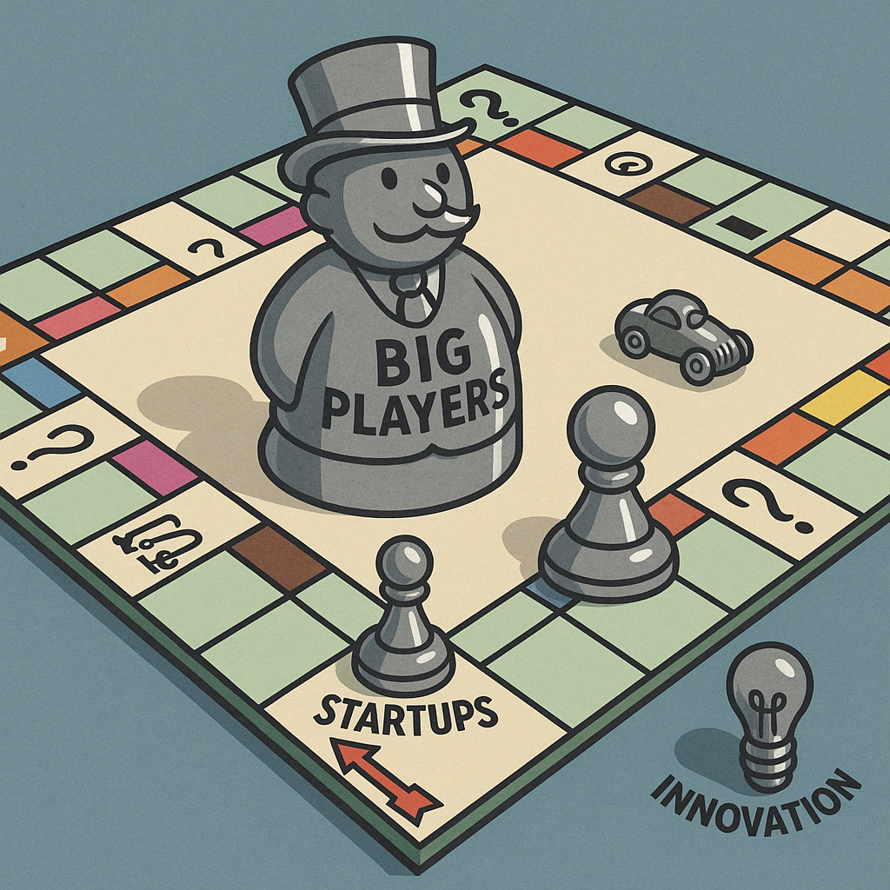
Why Tech Monopolies Matter
Market concentration reduces innovation and consumer choice.
Big Tech dominance influences democracy and society (Fukuyama, Richman, & Goel, 2021).
Image generated by ChatGPT (OpenAI, 2025).
Notes:
Tech monopolies directly impact consumers by reducing options and leaves innovation sidelined. Fukuyama, Richman, and Goel (2021) emphasize that these monopolies also influence civic and democratic life. For general audiences, I will explain monopoly simply as one company becoming so powerful that others cannot realistically compete. This concentration of power has far-reaching effects.

Slide 3
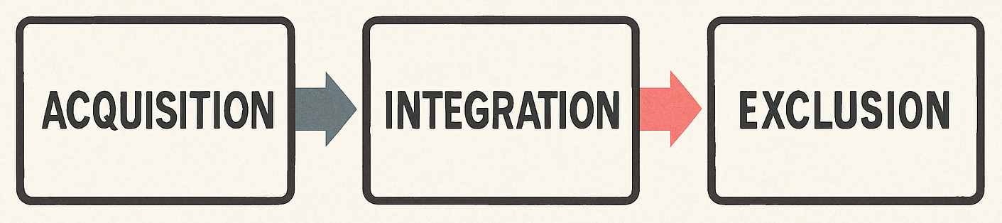
Tactics of Monopoly Power
Governance and Special Purpose Acquisition Company (SPAC) structures obscure accountability (Alon-Beck, Livingstone, Ofir, & Schwartz-Ziv, 2024).
Ad tech self-preferencing disadvantages rivals (Geradin & Katsifis, 2020).
Image generated by ChatGPT (OpenAI, 2025).
Notes:
Firms often employ strategies that reduce transparency and strengthen dominance. Alon-Beck, Livingstone, Ofir, and Schwartz-Ziv (2024) explain how SPACs and board arrangements limit oversight. Geradin and Katsifis (2020) show how Google’s ad tech practices give unfair preference to its own services. For non-technical listeners, I will compare this to changing the rules of a game while also serving as the referee. Simply put, large firms acquire smaller competitors or those with innovative technology potential, they then integrate them into their personal ecosystem and effectively buy out potential competition before they are ever able to sprout from the ground. This is a working case example of “too big to fail.”

Slide 4
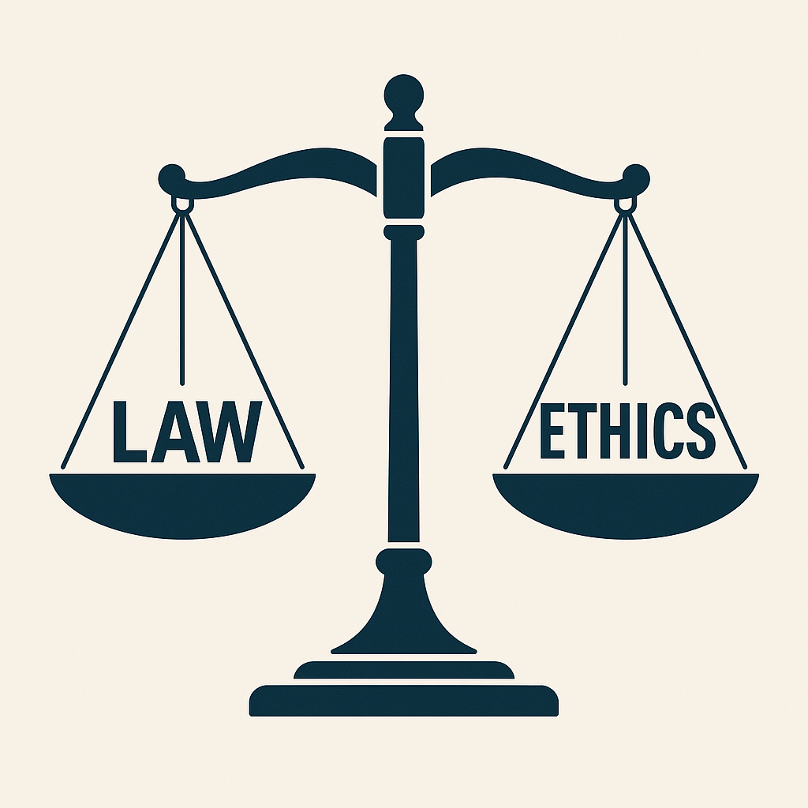
Legal and Ethical Dimensions
U.S. v. Google highlights legal and psychological factors (Heydt, 2024).
Platform–commerce conflicts reveal risks (Khan, 2019).
Facebook’s conduct described as structural cheating (Goldwater, 2024).
Image generated by ChatGPT (OpenAI, 2025).
Notes:
Monopolies create legal and ethical challenges. Heydt (2024) shows how psychology shapes interpretation of monopoly behavior in court. Khan (2019) emphasizes that platforms should not compete against the businesses they host. Goldwater (2024) labels Facebook’s conduct as structural cheating. Together, these examples demonstrate that monopolies are an issue of both law and fairness. When one entity holds all the power and control within an element of industry, it impedes innovation. It is important that we solidify our definitions of right-versus-wrong practices so that we can keep technology markets fair and equitable.

Slide 5
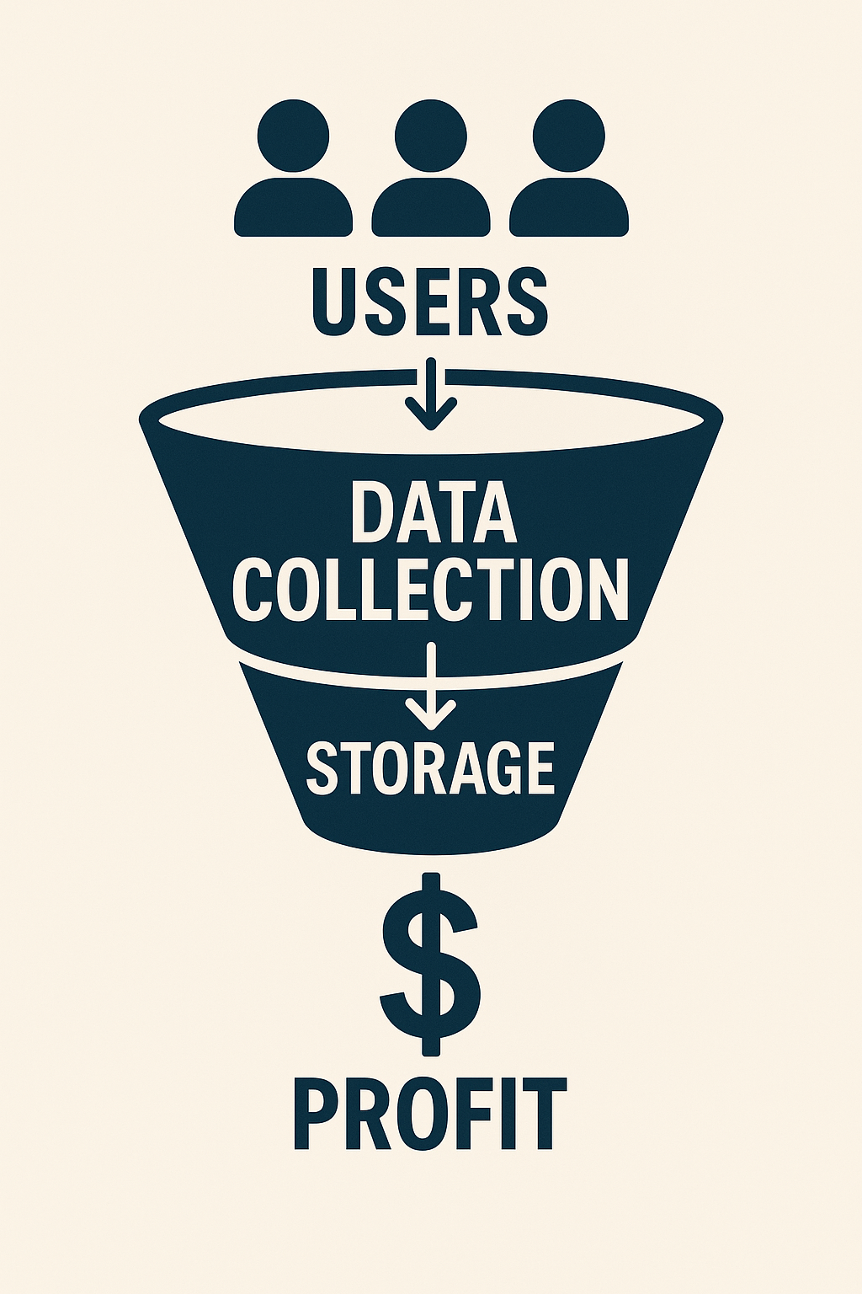
Data and Ownership Challenges
Data accumulation reinforces monopoly power (McIntosh, 2019).
New ownership models are needed (Hicks, 2023).
Copyright adapts with added-value models (Whitaker, 2019).
Image generated by ChatGPT (OpenAI, 2025).
Notes:
Data is the driving force Big Tech’s monopoly power. McIntosh (2019) argues that data collection and storage allow firms to dominate. Hicks (2023) proposes new models of data ownership to balance this power. Whitaker (2019) shows how copyright debates evolve as technology shifts. I will explain data as the raw fuel powering the digital economy. Our data has become a monetized asset for others, and intellectual property data is often absorbed by big tech before it ever grows into a competitive threat. Changing parameters within technology call for sustained improvements in policy to maintain fair competition.

Slide 6
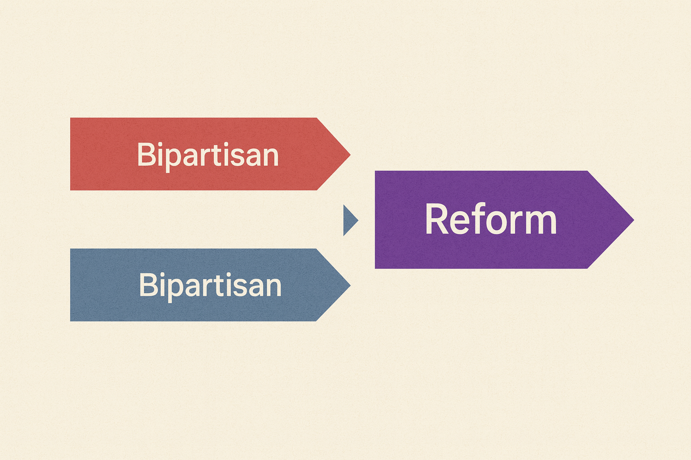
Policy and Bipartisan Momentum
Policymakers across parties support reform (Alford, 2022).
The common goal is fair markets that encourage innovation.
Image generated by ChatGPT (OpenAI, 2025).
Notes:
It is nothing new for members across the political aisle from one another to disagree on things. Despite political divides, Alford (2022) highlights bipartisan agreement to regulate Big Tech. This consensus shows that both parties recognize the risks posed by monopoly power and unfair competition in business markets. While approaches may differ, the agreement signals momentum for reform. This bipartisan framing reassures audiences that solutions are possible and readily welcomed.

Slide 7
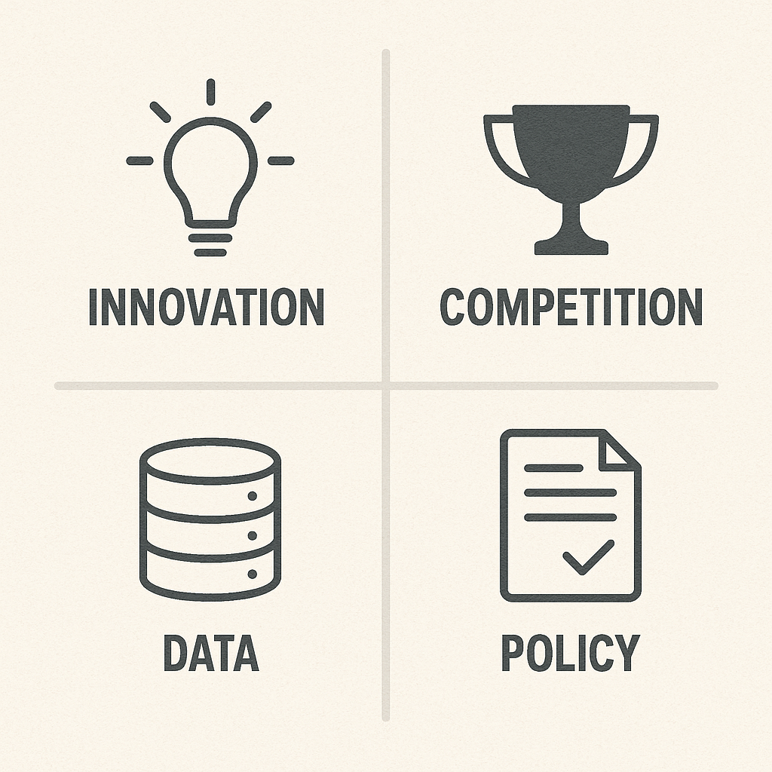
Conclusion and Takeaways
Monopolies affect innovation, competition, and democracy.
SPACs and advertising technology tactics strengthen dominance.
Data ownership debates shape future policy.
Reform has bipartisan support and is gaining momentum.
Image generated by ChatGPT (OpenAI, 2025).
Notes:
Monopolies affect not only competition, but also society and politics. SPACs and ad tech are examples of tactics that entrench power. Data ownership will be central to shaping future policies and will likely be a point of contention within the political landscape for many years to come. Finally, bipartisan consensus (Alford, 2022) indicates meaningful reform is on the horizon. This reinforces the importance of the issue for both technical and non-technical audiences.

Slide 8
References
Alford, R. P. (2022). The Bipartisan Consensus on Big Tech. Emory Law Journal, 71(5), 893–932. Retrieved from EBSCOhost.
Alon-Beck, A., Livingstone, J., Ofir, M., & Schwartz-Ziv, M. (2024). Unraveling the Web: Big Tech Directors, Spacs, and Antitrust Evasion Tactics. University of Pennsylvania Journal of Business Law, 26(3), 634–671. Retrieved from EBSCOhost.
Fukuyama, F., Richman, B., & Goel, A. (2021). How to Save Democracy from Technology: Ending Big Tech’s Information Monopoly. Foreign Affairs, 100(1), 98–110. Retrieved from EBSCOhost.
Goldwater, J. (2024). Did Facebook Cheat?: A Test Case of Antitrust Ethics. Journal of Business Ethics, 195(1), 133–149. Retrieved from EBSCOhost.
Geradin, D., & Katsifis, D. (2020). “Trust Me, I’m Fair”: Analysing Google’s Latest Practices in Ad Tech from the Perspective of EU Competition Law. European Competition Journal, 16(1), 11–54. Retrieved from EBSCOhost.
Heydt, J. (2024). Monopoly by Default: Psychology Meets Antitrust in United States V. Google. Law & Psychology Review, 49, 181–200. Retrieved from EBSCOhost.
Hicks, J. (2023). The future of data ownership: An uncommon research agenda. Sociological Review, 71(3), 544–560. Retrieved from EBSCOhost.
Khan, L. M. (2019). The Separation of Platforms and Commerce. Columbia Law Review, 119(4), 973–1098. Retrieved from EBSCOhost.
McIntosh, D. (2019). We Need to Talk about Data: How Digital Monopolies Arise and Why They Have Power and Influence. Journal of Technology Law & Policy, 23(2), 185– 213. Retrieved from EBSCOhost.
OpenAI. (2025). Images generated by ChatGPT [AI-generated image]. ChatGPT.
Whitaker, A. (2019). Shared Value over Fair Use: Technology, Added Value, and the Reinvention of Copyright. Cardozo Arts & Entertainment Law Journal, 37(3), 635–658. Retrieved from EBSCOhost.
Notes:
I will conclude with references to support the presentation and provide citations in proper APA7 format.

